Slide 1
Decision Tree

Slide 2
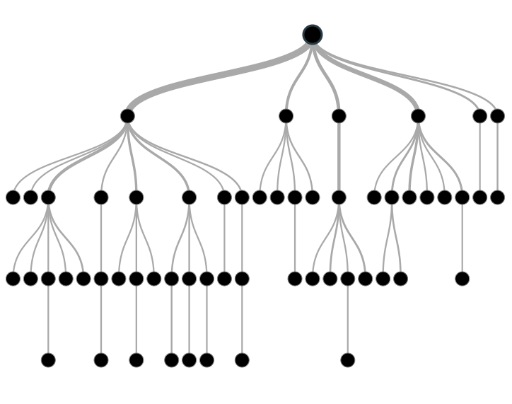
Decision Trees
One of the best and mostly used supervised learning methods
Tree based methods enables predictive models with high accuracy, stability and ease of interpretation.
Map non-linear relationships quite well
Can be used to solve both classification and regression problems

Slide 3
Decision Tree – Working
It is a type of supervised learning algorithm
Both categorical and continuous variables are supported for Input and output variables
We split the data set into two or more homogeneous subsets based on most significant splitter / differentiator in input variables

Slide 4
Decision Tree – Example
Let’s say we have a sample of 30 students with three variables Gender (Boy/ Girl), Class( IX/ X) and Height (5 to 6 ft.). 15 out of these 30 play cricket in leisure time. Now, I want to create a model to predict who will play cricket during leisure period? In this problem, we need to segregate students who play cricket in their leisure time based on highly significant input variable among all three.

Slide 5
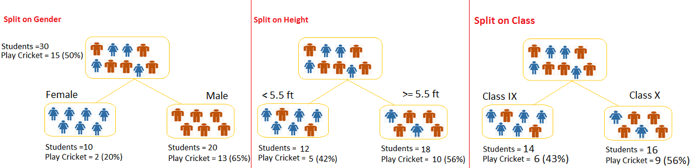
Decision Tree – Example

Slide 6
Types of Decision Trees
Categorical Variable Decision
Target variables are categorical
Continuous Variable Decision Tree
The target variable is continuous

Slide 7
Important Terminology
Root Node: It represents entire population or sample and this further gets divided into two or more homogeneous sets.
Splitting: It is a process of dividing a node into two or more sub-nodes.
Decision Node: When a sub-node splits into further sub-nodes, then it is called decision node.
Leaf / Terminal Node: Nodes do not split is called Leaf or Terminal node.

Slide 8
Important Terminology
Pruning: When we remove sub-nodes of a decision node, this process is called pruning. You can say opposite process of splitting.
Branch / Sub-Tree: A sub section of entire tree is called branch or sub-tree.
Parent and Child Node: A node, which is divided into sub-nodes is called parent node of sub-nodes where as sub-nodes are the child of parent node.

Slide 9
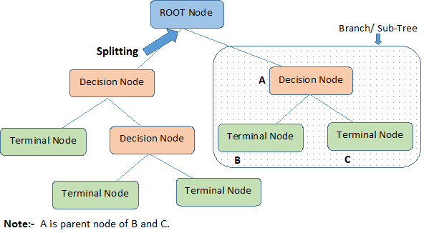
Important Terminology

Slide 10
Advantages of Decision Trees
Easy to understand even for non-technical people due to graphical representation
Useful in data exploration. Decision trees can quickly identify important variables and relation between two or more variables.
Less data cleaning is required than other approaches
Not severely affected by outliers and missing values
It can handle both numerical and categorical data
Non Parametric Method

Slide 11
Disadvantages of Decision Trees
Over fitting: Over fitting is one of the most practical difficulty for decision tree models.
Not ideal for continuous variables: While working with continuous numerical variables, decision tree looses information when it categorizes variables in different categories.

Slide 12
Regression Trees vs Classification Trees
In case of regression tree, the value obtained by terminal nodes in the training data is the mean response of observation falling in that region. Thus, if an unseen data observation falls in that region, we’ll make its prediction with mean value.
In case of classification tree, the value (class) obtained by terminal node in the training data is the mode of observations falling in that region. Thus, if an unseen data observation falls in that region, we’ll make its prediction with mode value.

Slide 13
Recursive Greedy Splitting
Both the trees divide the predictor space (independent variables) into distinct and non-overlapping regions. For the sake of simplicity, you can think of these regions as high dimensional boxes or boxes.
Both the trees follow a top-down greedy approach known as recursive binary splitting. We call it as ‘top-down’ because it begins from the top of tree when all the observations are available in a single region and successively splits the predictor space into two new branches down the tree. It is known as ‘greedy’ because, the algorithm cares (looks for best variable available) about only the current split, and not about future splits which will lead to a better tree.
This splitting process is continued until a user defined stopping criteria is reached. For example: we can tell the the algorithm to stop once the number of observations per node becomes less than 50.
In both the cases, the splitting process results in fully grown trees until the stopping criteria is reached. But, the fully grown tree is likely to overfit data, leading to poor accuracy on unseen data. This bring ‘pruning’. Pruning is one of the technique used tackle overfitting.

Slide 14
Decision Criteria
Multiple decision criteria are available to make a split
The decision criteria affects the tree’s accuracy
The creation of sub-nodes increases the homogeneity of resultant sub-nodes.
purity of the node increases with respect to the target variable
Decision tree splits the nodes on all available variables and then selects the split which results in most homogeneous sub-nodes.

Slide 15
Decision Criteria – Gini Index
If we select two items from a population at random then they must be of same class and probability for this is 1 if population is pure.
It works with categorical target variable “Success” or “Failure”.
It performs only Binary splits
Higher the value of Gini higher the homogeneity.
CART (Classification and Regression Tree) uses Gini method to create binary splits.

Slide 16
Decision Criteria – Gini Index Steps
Calculate Gini for sub-nodes, using formula sum of square of probability for success and failure (p^2+q^2).
Calculate Gini for split using weighted Gini score of each node of that split

Slide 17
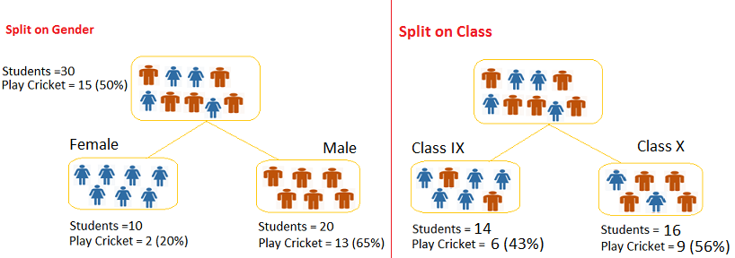
Decision Criteria – Gini Index
1. Calculate, Gini for sub-node Female = (0.2)*(0.2)+(0.8)*(0.8)=0.68
2. Gini for sub-node Male = (0.65)*(0.65)+(0.35)*(0.35)=0.55
3. Calculate weighted Gini for Split Gender = (10/30)*0.68+(20/30)*0.55 = 0.59
1. Gini for sub-node Class IX = (0.43)*(0.43)+(0.57)*(0.57)=0.51
2. Gini for sub-node Class X = (0.56)*(0.56)+(0.44)*(0.44)=0.51
3. Calculate weighted Gini for Split Class = (14/30)*0.51+(16/30)*0.51 = 0.51

Slide 18
Chi-Square
It finds out the statistical significance between the differences between sub-nodes and parent node.
measured by sum of squares of standardized differences between observed and expected frequencies of target variable.

Slide 19
Chi-Square
It works with categorical target variable “Success” or “Failure”.
It can perform two or more splits.
Higher the value of Chi-Square higher the statistical significance of differences between sub-node and Parent node.
Chi-Square of each node is calculated using formula,
Chi-square = ((Actual – Expected)^2 / Expected)^1/2
It generates tree called CHAID (Chi-square Automatic Interaction Detector)

Slide 20
How to Calculate Chi-Square
Calculate Chi-square for individual node by calculating the deviation for both Success and Failure
Calculated Chi-square of Split using Sum of all Chi-square of success and Failure of each node of the split

Slide 21
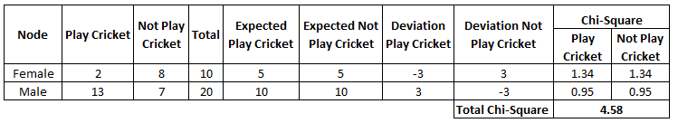
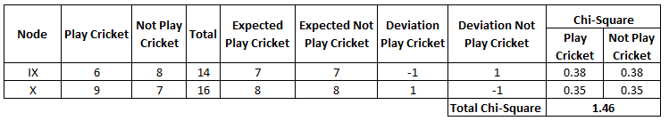
Chi-Square Example

Slide 22
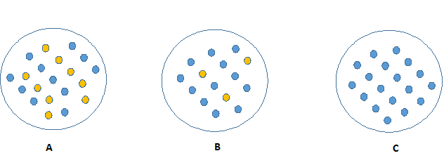
Information Gain
Pure node requires less information to describe it. And, more impure node requires more information.

Slide 23
Information Gain – Entropy
Information theory has a measure to define this degree of disorganization in a system known as Entropy.
If the sample is completely homogeneous, then the entropy is zero and,
If the sample is an equally divided (50% – 50%), it has entropy of one.
Information Gain = 1 - Entropy
Entropy can be calculated using formula:

Slide 24
Information Gain – Entropy
It chooses the split which has lowest entropy compared to parent node and other splits.
The lesser the entropy, the better it is.
How to calculate entropy
Calculate entropy of parent node
Calculate entropy of each individual node of split and calculate weighted average of all sub-nodes available in split.

Slide 25
Information Gain – Example
Entropy for parent node = -(15/30) log₂ (15/30) – (15/30) log₂ (15/30) = 1. Here 1 shows that it is a impure node.
SPLIT ON GENDER
Entropy for Female node = -(2/10) log₂ (2/10) – (8/10) log₂ (8/10) = 0.72 and for male node, -(13/20) log₂ (13/20) – (7/20) log₂ (7/20) = 0.93
Entropy for split Gender = Weighted entropy of sub-nodes = (10/30)*0.72 + (20/30)*0.93 = 0.86
SPLIT ON CLASS
Entropy for Class IX node, -(6/14) log₂ (6/14) – (8/14) log₂ (8/14) = 0.99 for Class X node, -(9/16) log₂ (9/16) – (7/16) log₂ (7/16) = 0.99.
Entropy for split Class = (14/30)*0.99 + (16/30)*0.99 = 0.99

Slide 26

Reduction in Variance
Reduction in variance is an algorithm used for continuous target variables (regression problems).
Uses standard variance formula
It splits according to each variable, and the split with the lowest variance is selected split

Slide 27
Steps to Reduce Variance
Calculate variance for each node.
Calculate variance for each split as weighted average of each node variance.
Reduction in variance is suited for continuous variables
However, the technique could be applied to categorical variables as well by converting to equivalent numerical values

Slide 28
Reduction in Variance – Example
Let’s assign numerical value 1 for play cricket and 0 for not playing cricket. Now follow the steps to identify the right split:
Variance for Root node: here mean value is (15*1 + 15*0)/30 = 0.5 and we have 15 one and 15 zero. Now variance would be ((1-0.5)^2+(1-0.5)^2+….15 times+(0-0.5)^2+(0-0.5)^2+…15 times) / 30, this can be written as (15*(1-0.5)^2+15*(0-0.5)^2) / 30 = 0.25
Mean of Female node = (2*1+8*0)/10=0.2 and Variance = (2*(1-0.2)^2+8*(0-0.2)^2) / 10 = 0.16
Mean of Male Node = (13*1+7*0)/20=0.65 and Variance = (13*(1-0.65)^2+7*(0-0.65)^2) / 20 = 0.23
Variance for Split Gender = Weighted Variance of Sub-nodes = (10/30)*0.16 + (20/30) *0.23 = 0.21
Mean of Class IX node = (6*1+8*0)/14=0.43 and Variance = (6*(1-0.43)^2+8*(0-0.43)^2) / 14= 0.24
Mean of Class X node = (9*1+7*0)/16=0.56 and Variance = (9*(1-0.56)^2+7*(0-0.56)^2) / 16 = 0.25
Variance for Split Class = (14/30)*0.24 + (16/30) *0.25 = 0.25

